Slide 1
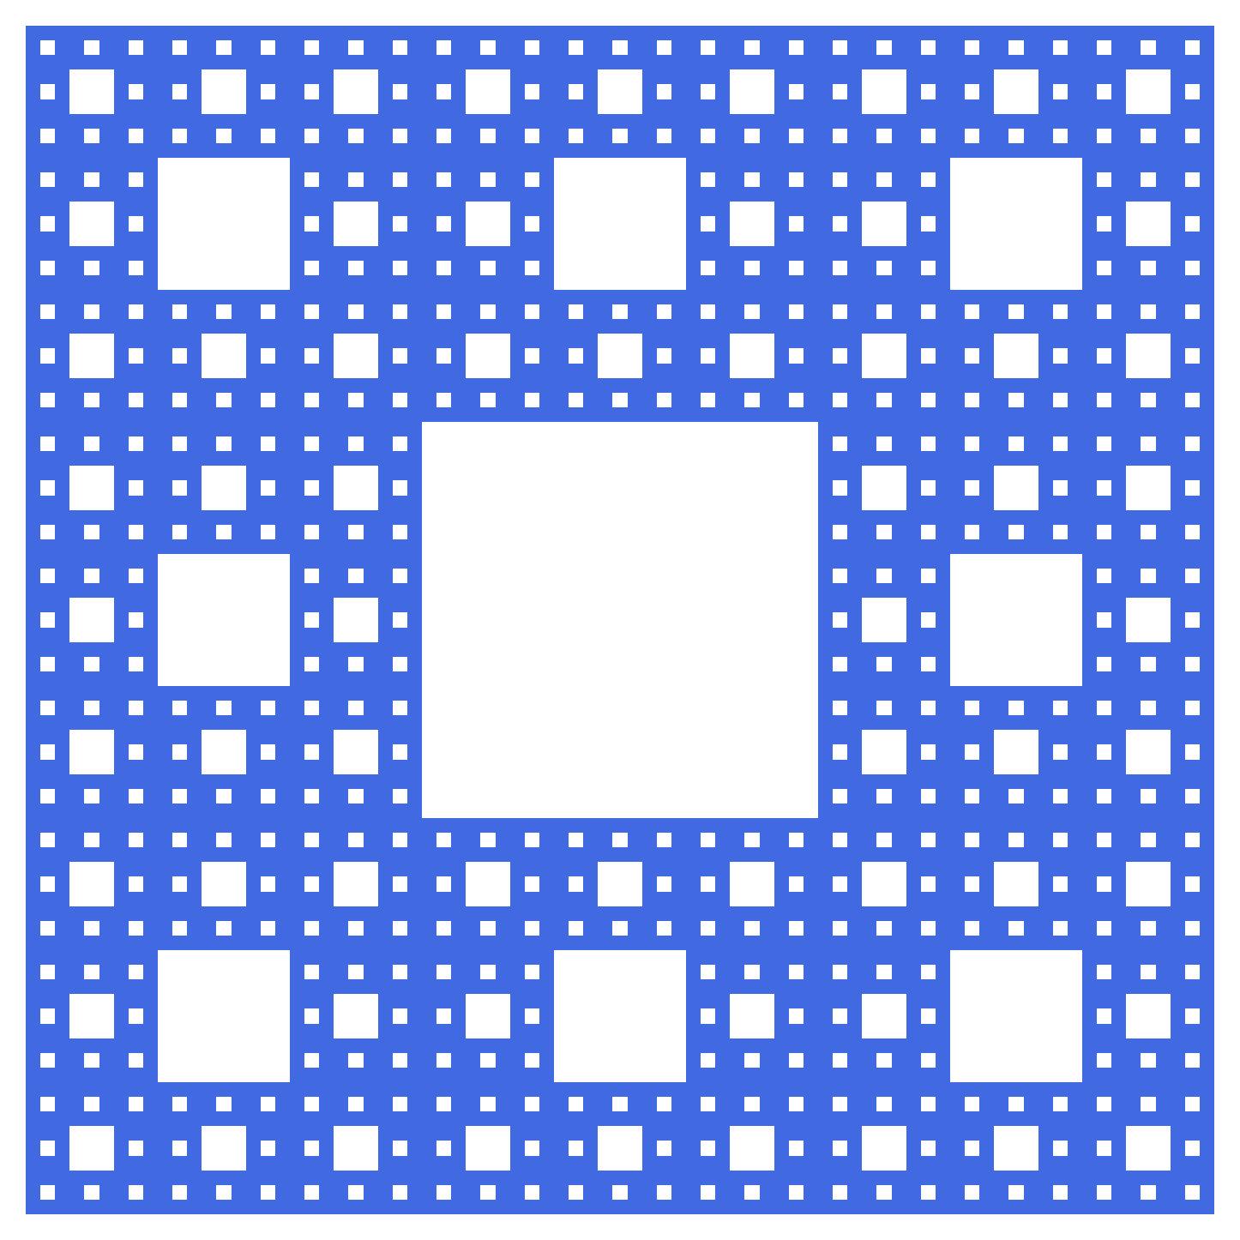
The Sierpiński Carpet*
Presentation By:
James Hutchinson

Slide 2
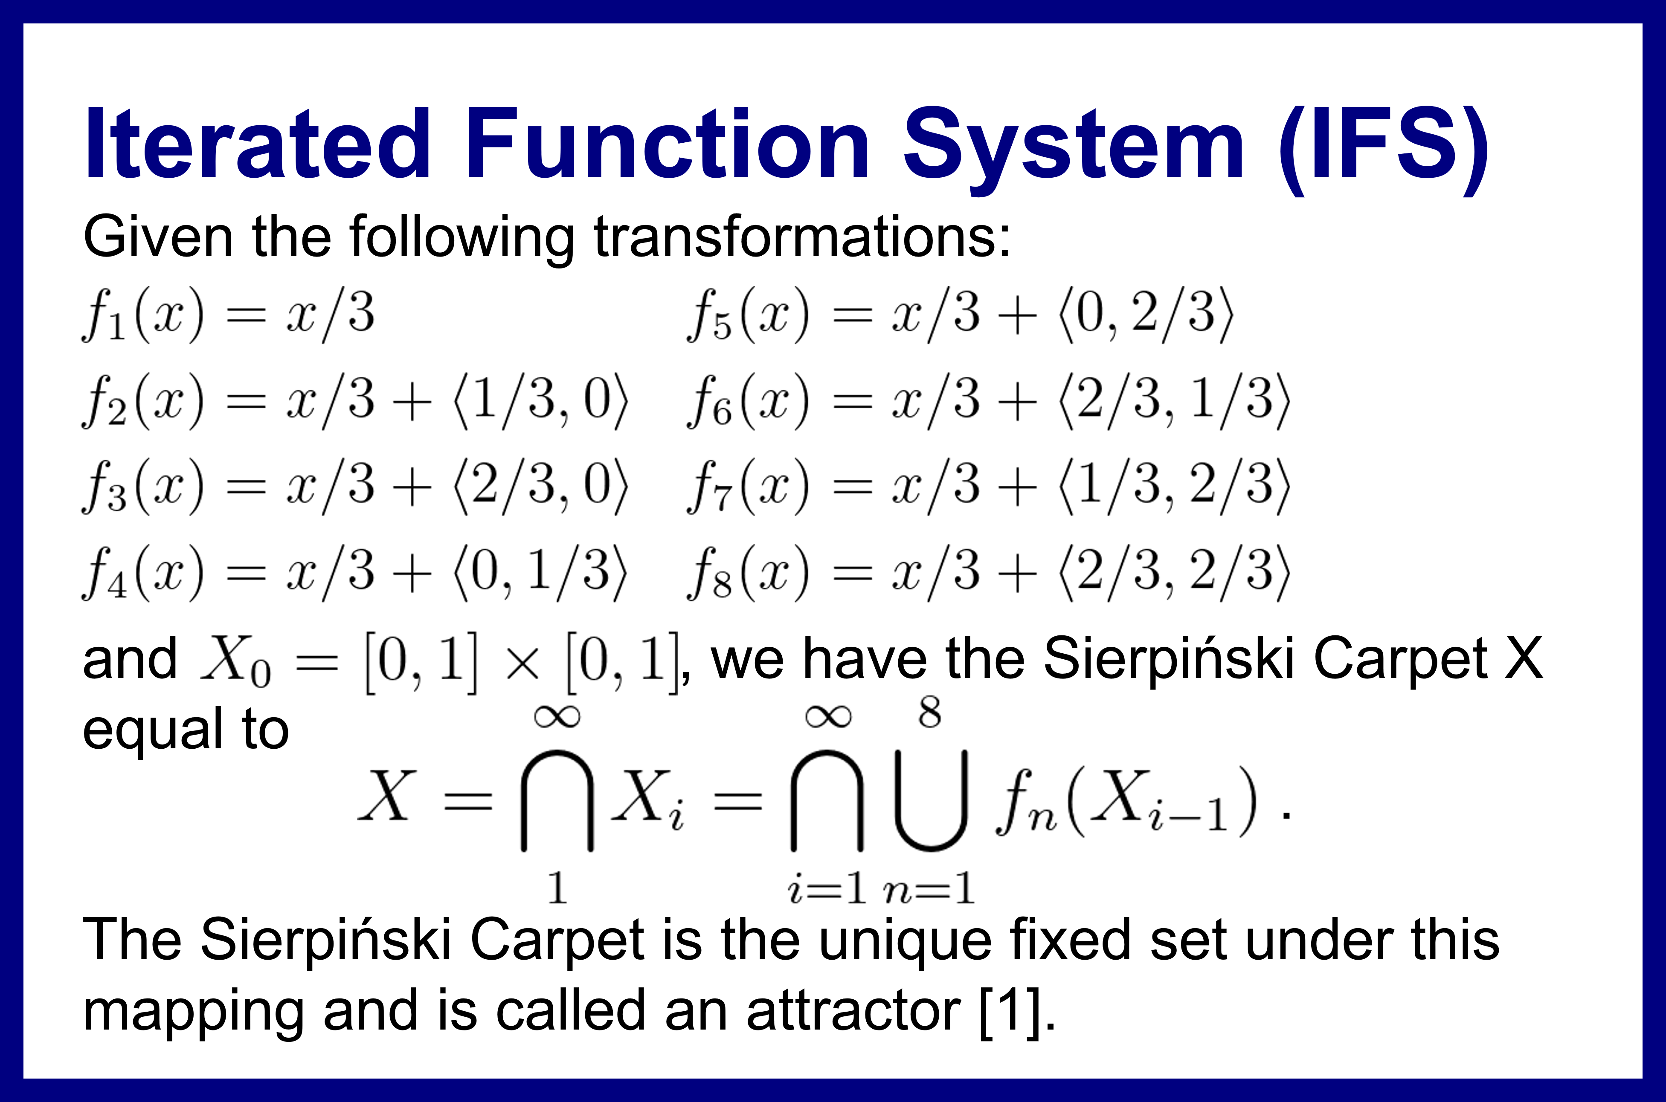
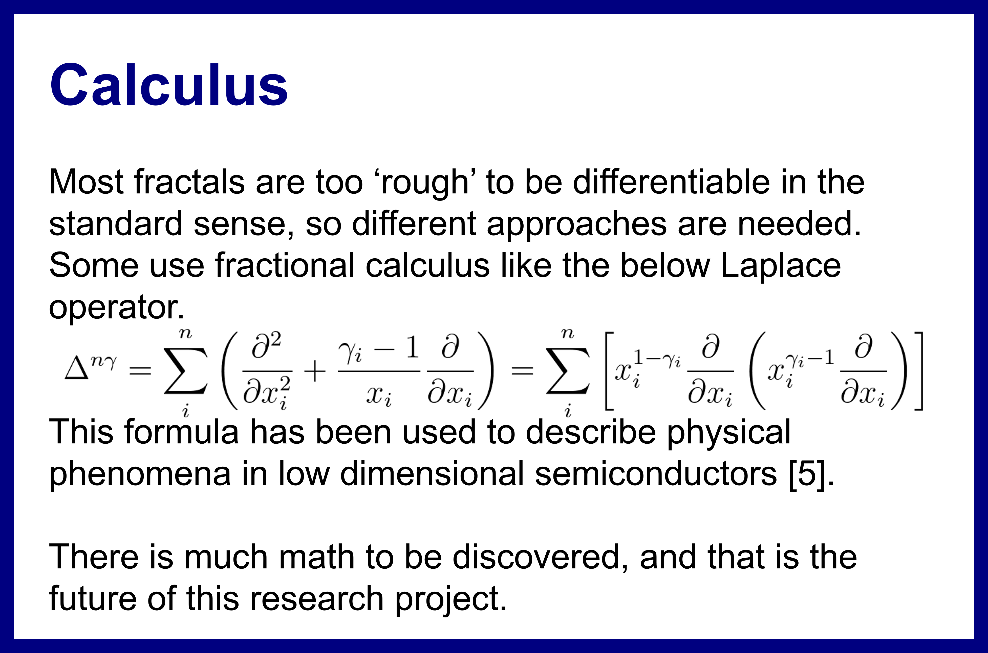
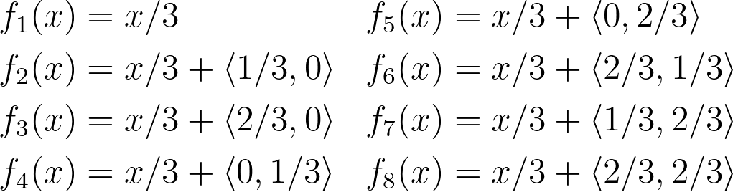
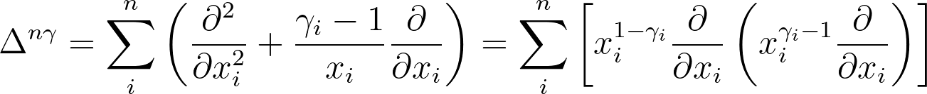
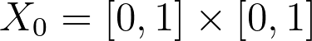
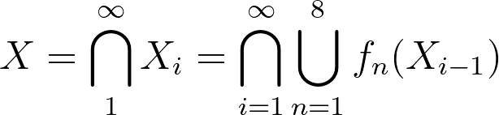
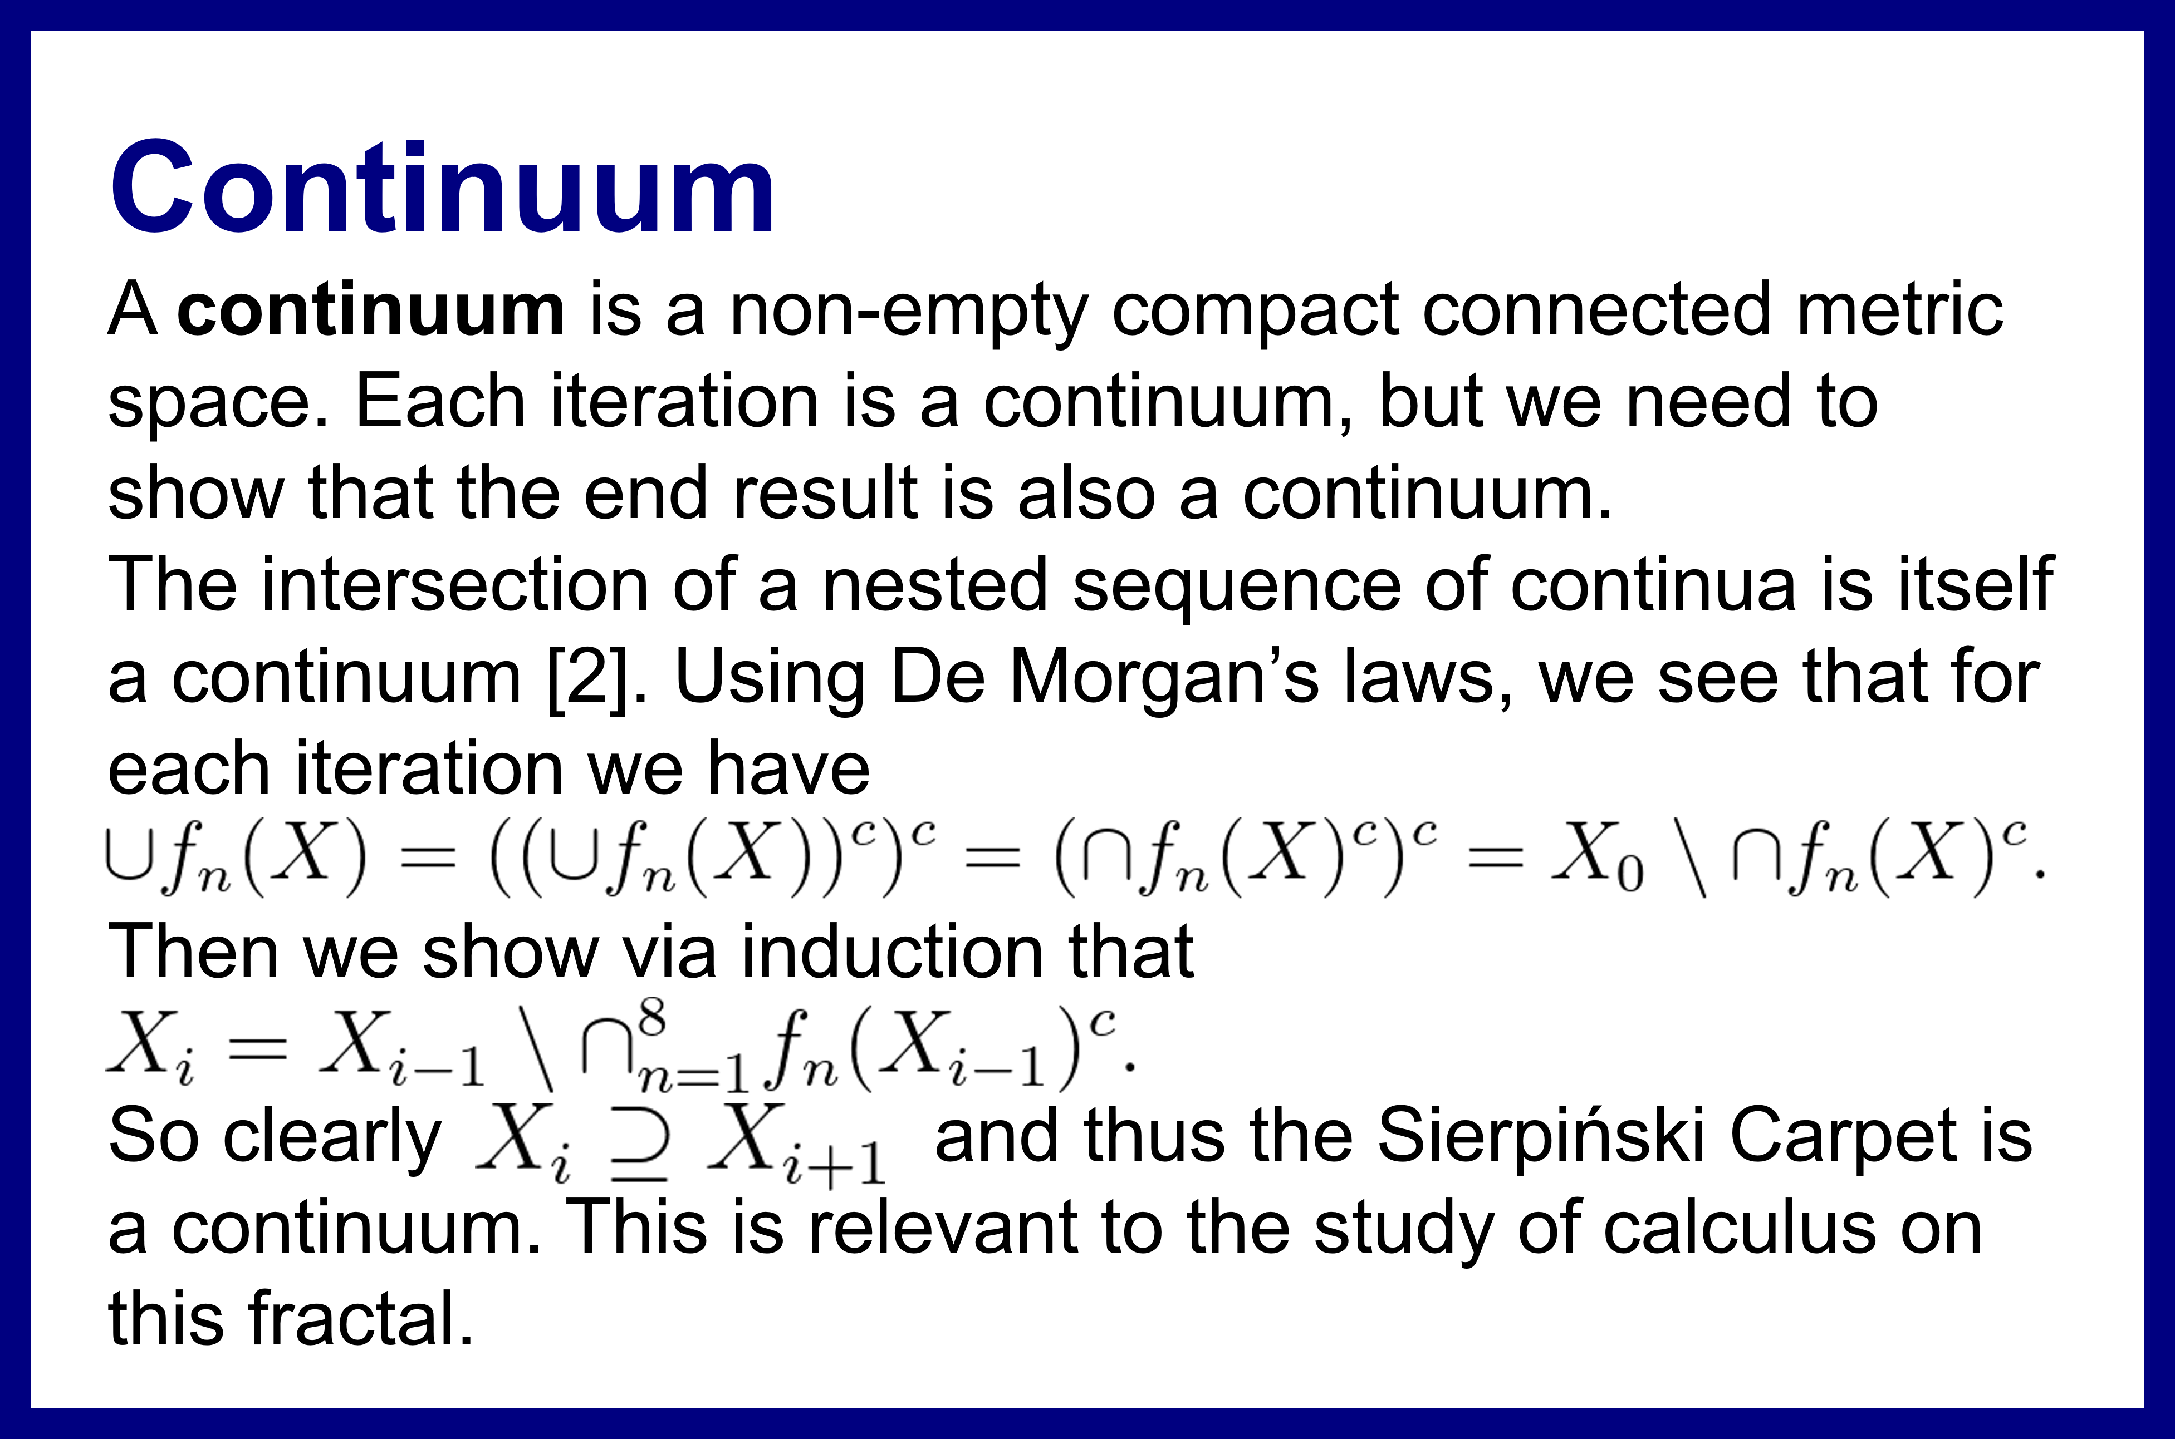
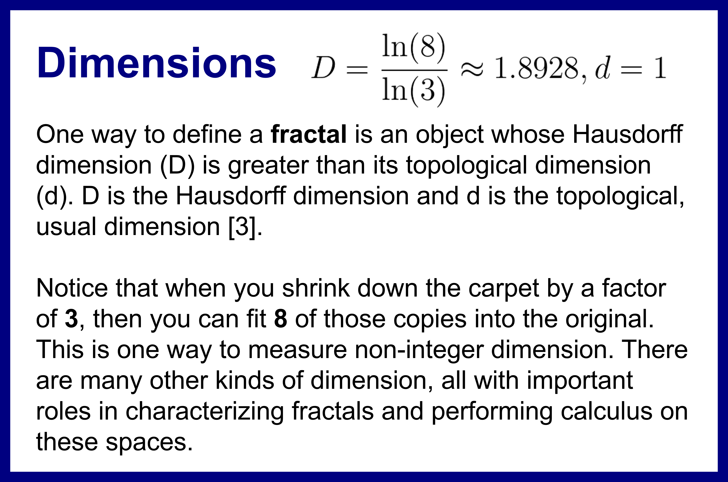
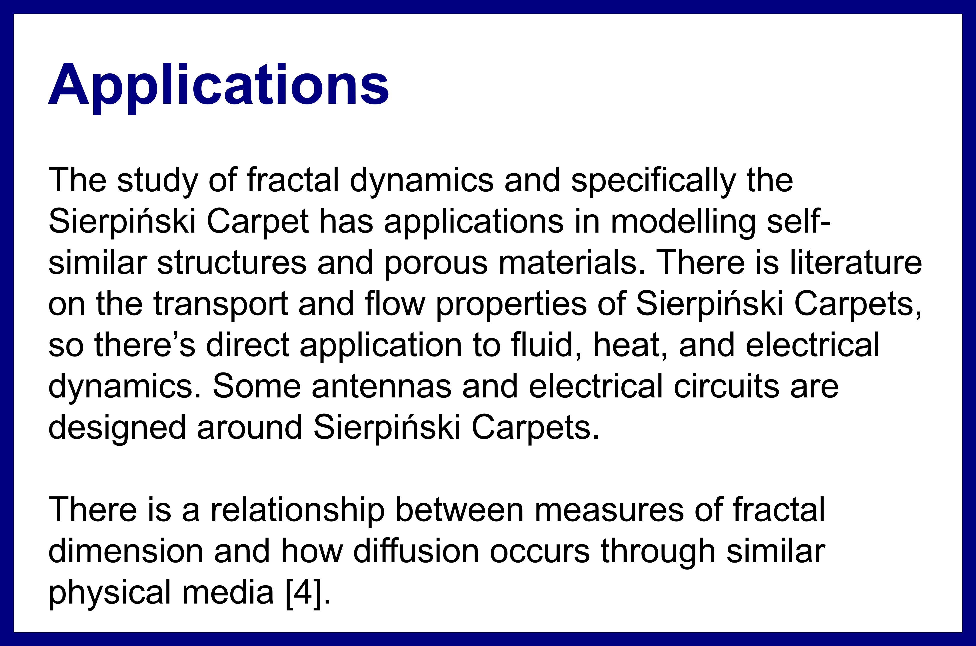
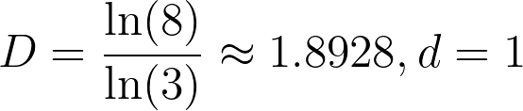
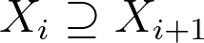
Abstract
The Sierpiński Carpet is a classic fractal obtained by taking a square, dividing it into 9 equal squares, removing the center square, and then repeating this process on the remaining 8 squares ad infinitum. It has many interesting properties and is subject to topological, analytic, and physical investigations.
This poster aims to introduce the reader to several important properties of the Carpet, specifically that it is an iterated function system, a continuum, has a non-integer Hausdorff dimension, and that performing calculus on fractal spaces requires non-standard approaches.
Exploring the
Sierpiński Carpet
James Hutchinson
References
[1] Falconer, K. (2003). Fractal geometry. https://doi.org/10.1002/0470013850
[2] Nadler, S. B. (1992). Continuum Theory: An Introduction.
[3] Ortiz, J. P., Ortiz, M. P., Martínez-Cruz, M., & Balankin, A. S. (2023). A Brief Survey of Paradigmatic Fractals from a Topological Perspective. Fractal and Fractional, 7(8), 597. https://doi.org/10.3390/fractalfract7080597
[4] Balankin, A. S. (2017). The topological Hausdorff dimension and transport properties of Sierpiński carpets. Physics Letters A, 381(34), 2801–2808. https://doi.org/10.1016/j.physleta.2017.06.049
[5] Balankin, A. S., & Mena, B. (2023). Vector differential operators in a fractional dimensional space, on fractals, and in fractal continua. Chaos Solitons & Fractals, 168, 113203. https://doi.org/10.1016/j.chaos.2023.113203
Iterated Function System (IFS)
Given the following transformations:
and , we have the Sierpiński Carpet X equal to
.
The Sierpiński Carpet is the unique fixed set under this mapping and is called an attractor [1].
Calculus
Most fractals are too ‘rough’ to be differentiable in the standard sense, so different approaches are needed. Some use fractional calculus like the below Laplace operator.
This formula has been used to describe physical phenomena in low dimensional semiconductors [5].
There is much math to be discovered, and that is the future of this research project.
Figure 1. Fourth-order approximation of the Sierpiński Carpet
Continuum
A continuum is a non-empty compact connected metric space. Each iteration is a continuum, but we need to show that the end result is also a continuum.
The intersection of a nested sequence of continua is itself a continuum [2]. Using De Morgan’s laws, we see that for each iteration we have
Then we show via induction that
So clearly and thus the Sierpiński Carpet is a continuum. This is relevant to the study of calculus on this fractal.
Dimensions
One way to define a fractal is an object whose Hausdorff dimension (D) is greater than its topological dimension (d). D is the Hausdorff dimension and d is the topological, usual dimension [3].
Notice that when you shrink down the carpet by a factor of 3, then you can fit 8 of those copies into the original. This is one way to measure non-integer dimension. There are many other kinds of dimension, all with important roles in characterizing fractals and performing calculus on these spaces.
Applications
The study of fractal dynamics and specifically the Sierpiński Carpet has applications in modelling self-similar structures and porous materials. There is literature on the transport and flow properties of Sierpiński Carpets, so there’s direct application to fluid, heat, and electrical dynamics. Some antennas and electrical circuits are designed around Sierpiński Carpets.
There is a relationship between measures of fractal dimension and how diffusion occurs through similar physical media [4].

Slide 3
Abstract
The Sierpiński Carpet is a classic fractal obtained by taking a square, dividing it into 9 equal squares, removing the center square, and then repeating this process on the remaining 8 squares ad infinitum. It has many interesting properties and is subject to topological, analytic, and physical investigations.
This poster aims to introduce the reader to several important properties of the Carpet, specifically that it is an iterated function system, a continuum, has a non-integer Hausdorff dimension, and that performing calculus on fractal spaces requires non-standard approaches.
Exploring the
Sierpiński Carpet
James Hutchinson
References
[1] Falconer, K. (2003). Fractal geometry. https://doi.org/10.1002/0470013850
[2] Nadler, S. B. (1992). Continuum Theory: An Introduction.
[3] Ortiz, J. P., Ortiz, M. P., Martínez-Cruz, M., & Balankin, A. S. (2023). A Brief Survey of Paradigmatic Fractals from a Topological Perspective. Fractal and Fractional, 7(8), 597. https://doi.org/10.3390/fractalfract7080597
[4] Balankin, A. S. (2017). The topological Hausdorff dimension and transport properties of Sierpiński carpets. Physics Letters A, 381(34), 2801–2808. https://doi.org/10.1016/j.physleta.2017.06.049
[5] Balankin, A. S., & Mena, B. (2023). Vector differential operators in a fractional dimensional space, on fractals, and in fractal continua. Chaos Solitons & Fractals, 168, 113203. https://doi.org/10.1016/j.chaos.2023.113203
Iterated Function System (IFS)
Given the following transformations:
and , we have the Sierpiński Carpet X equal to
.
The Sierpiński Carpet is the unique fixed set under this mapping and is called an attractor [1].
Calculus
Most fractals are too ‘rough’ to be differentiable in the standard sense, so different approaches are needed. Some use fractional calculus like the below Laplace operator.
This formula has been used to describe physical phenomena in low dimensional semiconductors [5].
There is much math to be discovered, and that is the future of this research project.
Figure 1. Fourth-order approximation of the Sierpiński Carpet
Continuum
A continuum is a non-empty compact connected metric space. Each iteration is a continuum, but we need to show that the end result is also a continuum.
The intersection of a nested sequence of continua is itself a continuum [2]. Using De Morgan’s laws, we see that for each iteration we have
Then we show via induction that
So clearly and thus the Sierpiński Carpet is a continuum. This is relevant to the study of calculus on this fractal.
Dimensions
One way to define a fractal is an object whose Hausdorff dimension (D) is greater than its topological dimension (d). D is the Hausdorff dimension and d is the topological, usual dimension [3].
Notice that when you shrink down the carpet by a factor of 3, then you can fit 8 of those copies into the original. This is one way to measure non-integer dimension. There are many other kinds of dimension, all with important roles in characterizing fractals and performing calculus on these spaces.
Applications
The study of fractal dynamics and specifically the Sierpiński Carpet has applications in modelling self-similar structures and porous materials. There is literature on the transport and flow properties of Sierpiński Carpets, so there’s direct application to fluid, heat, and electrical dynamics. Some antennas and electrical circuits are designed around Sierpiński Carpets.
There is a relationship between measures of fractal dimension and how diffusion occurs through similar physical media [4].

Slide 4
Abstract
The Sierpiński Carpet is a classic fractal obtained by taking a square, dividing it into 9 equal squares, removing the center square, and then repeating this process on the remaining 8 squares ad infinitum. It has many interesting properties and is subject to topological, analytic, and physical investigations.
This poster aims to introduce the reader to several important properties of the Carpet, specifically that it is an iterated function system, a continuum, has a non-integer Hausdorff dimension, and that performing calculus on fractal spaces requires non-standard approaches.
Exploring the
Sierpiński Carpet
James Hutchinson
References
[1] Falconer, K. (2003). Fractal geometry. https://doi.org/10.1002/0470013850
[2] Nadler, S. B. (1992). Continuum Theory: An Introduction.
[3] Ortiz, J. P., Ortiz, M. P., Martínez-Cruz, M., & Balankin, A. S. (2023). A Brief Survey of Paradigmatic Fractals from a Topological Perspective. Fractal and Fractional, 7(8), 597. https://doi.org/10.3390/fractalfract7080597
[4] Balankin, A. S. (2017). The topological Hausdorff dimension and transport properties of Sierpiński carpets. Physics Letters A, 381(34), 2801–2808. https://doi.org/10.1016/j.physleta.2017.06.049
[5] Balankin, A. S., & Mena, B. (2023). Vector differential operators in a fractional dimensional space, on fractals, and in fractal continua. Chaos Solitons & Fractals, 168, 113203. https://doi.org/10.1016/j.chaos.2023.113203
Iterated Function System (IFS)
Given the following transformations:
and , we have the Sierpiński Carpet X equal to
.
The Sierpiński Carpet is the unique fixed set under this mapping and is called an attractor [1].
Calculus
Most fractals are too ‘rough’ to be differentiable in the standard sense, so different approaches are needed. Some use fractional calculus like the below Laplace operator.
This formula has been used to describe physical phenomena in low dimensional semiconductors [5].
There is much math to be discovered, and that is the future of this research project.
Figure 1. Fourth-order approximation of the Sierpiński Carpet
Continuum
A continuum is a non-empty compact connected metric space. Each iteration is a continuum, but we need to show that the end result is also a continuum.
The intersection of a nested sequence of continua is itself a continuum [2]. Using De Morgan’s laws, we see that for each iteration we have
Then we show via induction that
So clearly and thus the Sierpiński Carpet is a continuum. This is relevant to the study of calculus on this fractal.
Dimensions
One way to define a fractal is an object whose Hausdorff dimension (D) is greater than its topological dimension (d). D is the Hausdorff dimension and d is the topological, usual dimension [3].
Notice that when you shrink down the carpet by a factor of 3, then you can fit 8 of those copies into the original. This is one way to measure non-integer dimension. There are many other kinds of dimension, all with important roles in characterizing fractals and performing calculus on these spaces.
Applications
The study of fractal dynamics and specifically the Sierpiński Carpet has applications in modelling self-similar structures and porous materials. There is literature on the transport and flow properties of Sierpiński Carpets, so there’s direct application to fluid, heat, and electrical dynamics. Some antennas and electrical circuits are designed around Sierpiński Carpets.
There is a relationship between measures of fractal dimension and how diffusion occurs through similar physical media [4].

Slide 5
Abstract
The Sierpiński Carpet is a classic fractal obtained by taking a square, dividing it into 9 equal squares, removing the center square, and then repeating this process on the remaining 8 squares ad infinitum. It has many interesting properties and is subject to topological, analytic, and physical investigations.
This poster aims to introduce the reader to several important properties of the Carpet, specifically that it is an iterated function system, a continuum, has a non-integer Hausdorff dimension, and that performing calculus on fractal spaces requires non-standard approaches.
Exploring the
Sierpiński Carpet
James Hutchinson
References
[1] Falconer, K. (2003). Fractal geometry. https://doi.org/10.1002/0470013850
[2] Nadler, S. B. (1992). Continuum Theory: An Introduction.
[3] Ortiz, J. P., Ortiz, M. P., Martínez-Cruz, M., & Balankin, A. S. (2023). A Brief Survey of Paradigmatic Fractals from a Topological Perspective. Fractal and Fractional, 7(8), 597. https://doi.org/10.3390/fractalfract7080597
[4] Balankin, A. S. (2017). The topological Hausdorff dimension and transport properties of Sierpiński carpets. Physics Letters A, 381(34), 2801–2808. https://doi.org/10.1016/j.physleta.2017.06.049
[5] Balankin, A. S., & Mena, B. (2023). Vector differential operators in a fractional dimensional space, on fractals, and in fractal continua. Chaos Solitons & Fractals, 168, 113203. https://doi.org/10.1016/j.chaos.2023.113203
Iterated Function System (IFS)
Given the following transformations:
and , we have the Sierpiński Carpet X equal to
.
The Sierpiński Carpet is the unique fixed set under this mapping and is called an attractor [1].
Calculus
Most fractals are too ‘rough’ to be differentiable in the standard sense, so different approaches are needed. Some use fractional calculus like the below Laplace operator.
This formula has been used to describe physical phenomena in low dimensional semiconductors [5].
There is much math to be discovered, and that is the future of this research project.
Figure 1. Fourth-order approximation of the Sierpiński Carpet
Continuum
A continuum is a non-empty compact connected metric space. Each iteration is a continuum, but we need to show that the end result is also a continuum.
The intersection of a nested sequence of continua is itself a continuum [2]. Using De Morgan’s laws, we see that for each iteration we have
Then we show via induction that
So clearly and thus the Sierpiński Carpet is a continuum. This is relevant to the study of calculus on this fractal.
Dimensions
One way to define a fractal is an object whose Hausdorff dimension (D) is greater than its topological dimension (d). D is the Hausdorff dimension and d is the topological, usual dimension [3].
Notice that when you shrink down the carpet by a factor of 3, then you can fit 8 of those copies into the original. This is one way to measure non-integer dimension. There are many other kinds of dimension, all with important roles in characterizing fractals and performing calculus on these spaces.
Applications
The study of fractal dynamics and specifically the Sierpiński Carpet has applications in modelling self-similar structures and porous materials. There is literature on the transport and flow properties of Sierpiński Carpets, so there’s direct application to fluid, heat, and electrical dynamics. Some antennas and electrical circuits are designed around Sierpiński Carpets.
There is a relationship between measures of fractal dimension and how diffusion occurs through similar physical media [4].

Slide 6
Abstract
The Sierpiński Carpet is a classic fractal obtained by taking a square, dividing it into 9 equal squares, removing the center square, and then repeating this process on the remaining 8 squares ad infinitum. It has many interesting properties and is subject to topological, analytic, and physical investigations.
This poster aims to introduce the reader to several important properties of the Carpet, specifically that it is an iterated function system, a continuum, has a non-integer Hausdorff dimension, and that performing calculus on fractal spaces requires non-standard approaches.
Exploring the
Sierpiński Carpet
James Hutchinson
References
[1] Falconer, K. (2003). Fractal geometry. https://doi.org/10.1002/0470013850
[2] Nadler, S. B. (1992). Continuum Theory: An Introduction.
[3] Ortiz, J. P., Ortiz, M. P., Martínez-Cruz, M., & Balankin, A. S. (2023). A Brief Survey of Paradigmatic Fractals from a Topological Perspective. Fractal and Fractional, 7(8), 597. https://doi.org/10.3390/fractalfract7080597
[4] Balankin, A. S. (2017). The topological Hausdorff dimension and transport properties of Sierpiński carpets. Physics Letters A, 381(34), 2801–2808. https://doi.org/10.1016/j.physleta.2017.06.049
[5] Balankin, A. S., & Mena, B. (2023). Vector differential operators in a fractional dimensional space, on fractals, and in fractal continua. Chaos Solitons & Fractals, 168, 113203. https://doi.org/10.1016/j.chaos.2023.113203
Iterated Function System (IFS)
Given the following transformations:
and , we have the Sierpiński Carpet X equal to
.
The Sierpiński Carpet is the unique fixed set under this mapping and is called an attractor [1].
Calculus
Most fractals are too ‘rough’ to be differentiable in the standard sense, so different approaches are needed. Some use fractional calculus like the below Laplace operator.
This formula has been used to describe physical phenomena in low dimensional semiconductors [5].
There is much math to be discovered, and that is the future of this research project.
Figure 1. Fourth-order approximation of the Sierpiński Carpet
Continuum
A continuum is a non-empty compact connected metric space. Each iteration is a continuum, but we need to show that the end result is also a continuum.
The intersection of a nested sequence of continua is itself a continuum [2]. Using De Morgan’s laws, we see that for each iteration we have
Then we show via induction that
So clearly and thus the Sierpiński Carpet is a continuum. This is relevant to the study of calculus on this fractal.
Dimensions
One way to define a fractal is an object whose Hausdorff dimension (D) is greater than its topological dimension (d). D is the Hausdorff dimension and d is the topological, usual dimension [3].
Notice that when you shrink down the carpet by a factor of 3, then you can fit 8 of those copies into the original. This is one way to measure non-integer dimension. There are many other kinds of dimension, all with important roles in characterizing fractals and performing calculus on these spaces.
Applications
The study of fractal dynamics and specifically the Sierpiński Carpet has applications in modelling self-similar structures and porous materials. There is literature on the transport and flow properties of Sierpiński Carpets, so there’s direct application to fluid, heat, and electrical dynamics. Some antennas and electrical circuits are designed around Sierpiński Carpets.
There is a relationship between measures of fractal dimension and how diffusion occurs through similar physical media [4].

Slide 7
Abstract
The Sierpiński Carpet is a classic fractal obtained by taking a square, dividing it into 9 equal squares, removing the center square, and then repeating this process on the remaining 8 squares ad infinitum. It has many interesting properties and is subject to topological, analytic, and physical investigations.
This poster aims to introduce the reader to several important properties of the Carpet, specifically that it is an iterated function system, a continuum, has a non-integer Hausdorff dimension, and that performing calculus on fractal spaces requires non-standard approaches.
Exploring the
Sierpiński Carpet
James Hutchinson
References
[1] Falconer, K. (2003). Fractal geometry. https://doi.org/10.1002/0470013850
[2] Nadler, S. B. (1992). Continuum Theory: An Introduction.
[3] Ortiz, J. P., Ortiz, M. P., Martínez-Cruz, M., & Balankin, A. S. (2023). A Brief Survey of Paradigmatic Fractals from a Topological Perspective. Fractal and Fractional, 7(8), 597. https://doi.org/10.3390/fractalfract7080597
[4] Balankin, A. S. (2017). The topological Hausdorff dimension and transport properties of Sierpiński carpets. Physics Letters A, 381(34), 2801–2808. https://doi.org/10.1016/j.physleta.2017.06.049
[5] Balankin, A. S., & Mena, B. (2023). Vector differential operators in a fractional dimensional space, on fractals, and in fractal continua. Chaos Solitons & Fractals, 168, 113203. https://doi.org/10.1016/j.chaos.2023.113203
Iterated Function System (IFS)
Given the following transformations:
and , we have the Sierpiński Carpet X equal to
.
The Sierpiński Carpet is the unique fixed set under this mapping and is called an attractor [1].
Calculus
Most fractals are too ‘rough’ to be differentiable in the standard sense, so different approaches are needed. Some use fractional calculus like the below Laplace operator.
This formula has been used to describe physical phenomena in low dimensional semiconductors [5].
There is much math to be discovered, and that is the future of this research project.
Figure 1. Fourth-order approximation of the Sierpiński Carpet
Continuum
A continuum is a non-empty compact connected metric space. Each iteration is a continuum, but we need to show that the end result is also a continuum.
The intersection of a nested sequence of continua is itself a continuum [2]. Using De Morgan’s laws, we see that for each iteration we have
Then we show via induction that
So clearly and thus the Sierpiński Carpet is a continuum. This is relevant to the study of calculus on this fractal.
Dimensions
One way to define a fractal is an object whose Hausdorff dimension (D) is greater than its topological dimension (d). D is the Hausdorff dimension and d is the topological, usual dimension [3].
Notice that when you shrink down the carpet by a factor of 3, then you can fit 8 of those copies into the original. This is one way to measure non-integer dimension. There are many other kinds of dimension, all with important roles in characterizing fractals and performing calculus on these spaces.
Applications
The study of fractal dynamics and specifically the Sierpiński Carpet has applications in modelling self-similar structures and porous materials. There is literature on the transport and flow properties of Sierpiński Carpets, so there’s direct application to fluid, heat, and electrical dynamics. Some antennas and electrical circuits are designed around Sierpiński Carpets.
There is a relationship between measures of fractal dimension and how diffusion occurs through similar physical media [4].

Slide 8
Abstract
The Sierpiński Carpet is a classic fractal obtained by taking a square, dividing it into 9 equal squares, removing the center square, and then repeating this process on the remaining 8 squares ad infinitum. It has many interesting properties and is subject to topological, analytic, and physical investigations.
This poster aims to introduce the reader to several important properties of the Carpet, specifically that it is an iterated function system, a continuum, has a non-integer Hausdorff dimension, and that performing calculus on fractal spaces requires non-standard approaches.
Exploring the
Sierpiński Carpet
James Hutchinson
References
[1] Falconer, K. (2003). Fractal geometry. https://doi.org/10.1002/0470013850
[2] Nadler, S. B. (1992). Continuum Theory: An Introduction.
[3] Ortiz, J. P., Ortiz, M. P., Martínez-Cruz, M., & Balankin, A. S. (2023). A Brief Survey of Paradigmatic Fractals from a Topological Perspective. Fractal and Fractional, 7(8), 597. https://doi.org/10.3390/fractalfract7080597
[4] Balankin, A. S. (2017). The topological Hausdorff dimension and transport properties of Sierpiński carpets. Physics Letters A, 381(34), 2801–2808. https://doi.org/10.1016/j.physleta.2017.06.049
[5] Balankin, A. S., & Mena, B. (2023). Vector differential operators in a fractional dimensional space, on fractals, and in fractal continua. Chaos Solitons & Fractals, 168, 113203. https://doi.org/10.1016/j.chaos.2023.113203
Iterated Function System (IFS)
Given the following transformations:
and , we have the Sierpiński Carpet X equal to
.
The Sierpiński Carpet is the unique fixed set under this mapping and is called an attractor [1].
Calculus
Most fractals are too ‘rough’ to be differentiable in the standard sense, so different approaches are needed. Some use fractional calculus like the below Laplace operator.
This formula has been used to describe physical phenomena in low dimensional semiconductors [5].
There is much math to be discovered, and that is the future of this research project.
Figure 1. Fourth-order approximation of the Sierpiński Carpet
Continuum
A continuum is a non-empty compact connected metric space. Each iteration is a continuum, but we need to show that the end result is also a continuum.
The intersection of a nested sequence of continua is itself a continuum [2]. Using De Morgan’s laws, we see that for each iteration we have
Then we show via induction that
So clearly and thus the Sierpiński Carpet is a continuum. This is relevant to the study of calculus on this fractal.
Dimensions
One way to define a fractal is an object whose Hausdorff dimension (D) is greater than its topological dimension (d). D is the Hausdorff dimension and d is the topological, usual dimension [3].
Notice that when you shrink down the carpet by a factor of 3, then you can fit 8 of those copies into the original. This is one way to measure non-integer dimension. There are many other kinds of dimension, all with important roles in characterizing fractals and performing calculus on these spaces.
Applications
The study of fractal dynamics and specifically the Sierpiński Carpet has applications in modelling self-similar structures and porous materials. There is literature on the transport and flow properties of Sierpiński Carpets, so there’s direct application to fluid, heat, and electrical dynamics. Some antennas and electrical circuits are designed around Sierpiński Carpets.
There is a relationship between measures of fractal dimension and how diffusion occurs through similar physical media [4].

Slide 9
DIY Carpet
Starting Point

Slide 10
DIY Carpet

Slide 11
DIY Carpet
Round 1

Slide 12
DIY Carpet

Slide 13
DIY Carpet
Round 2

Slide 14
DIY Carpet

Slide 15
DIY Carpet
Round 3

Slide 16
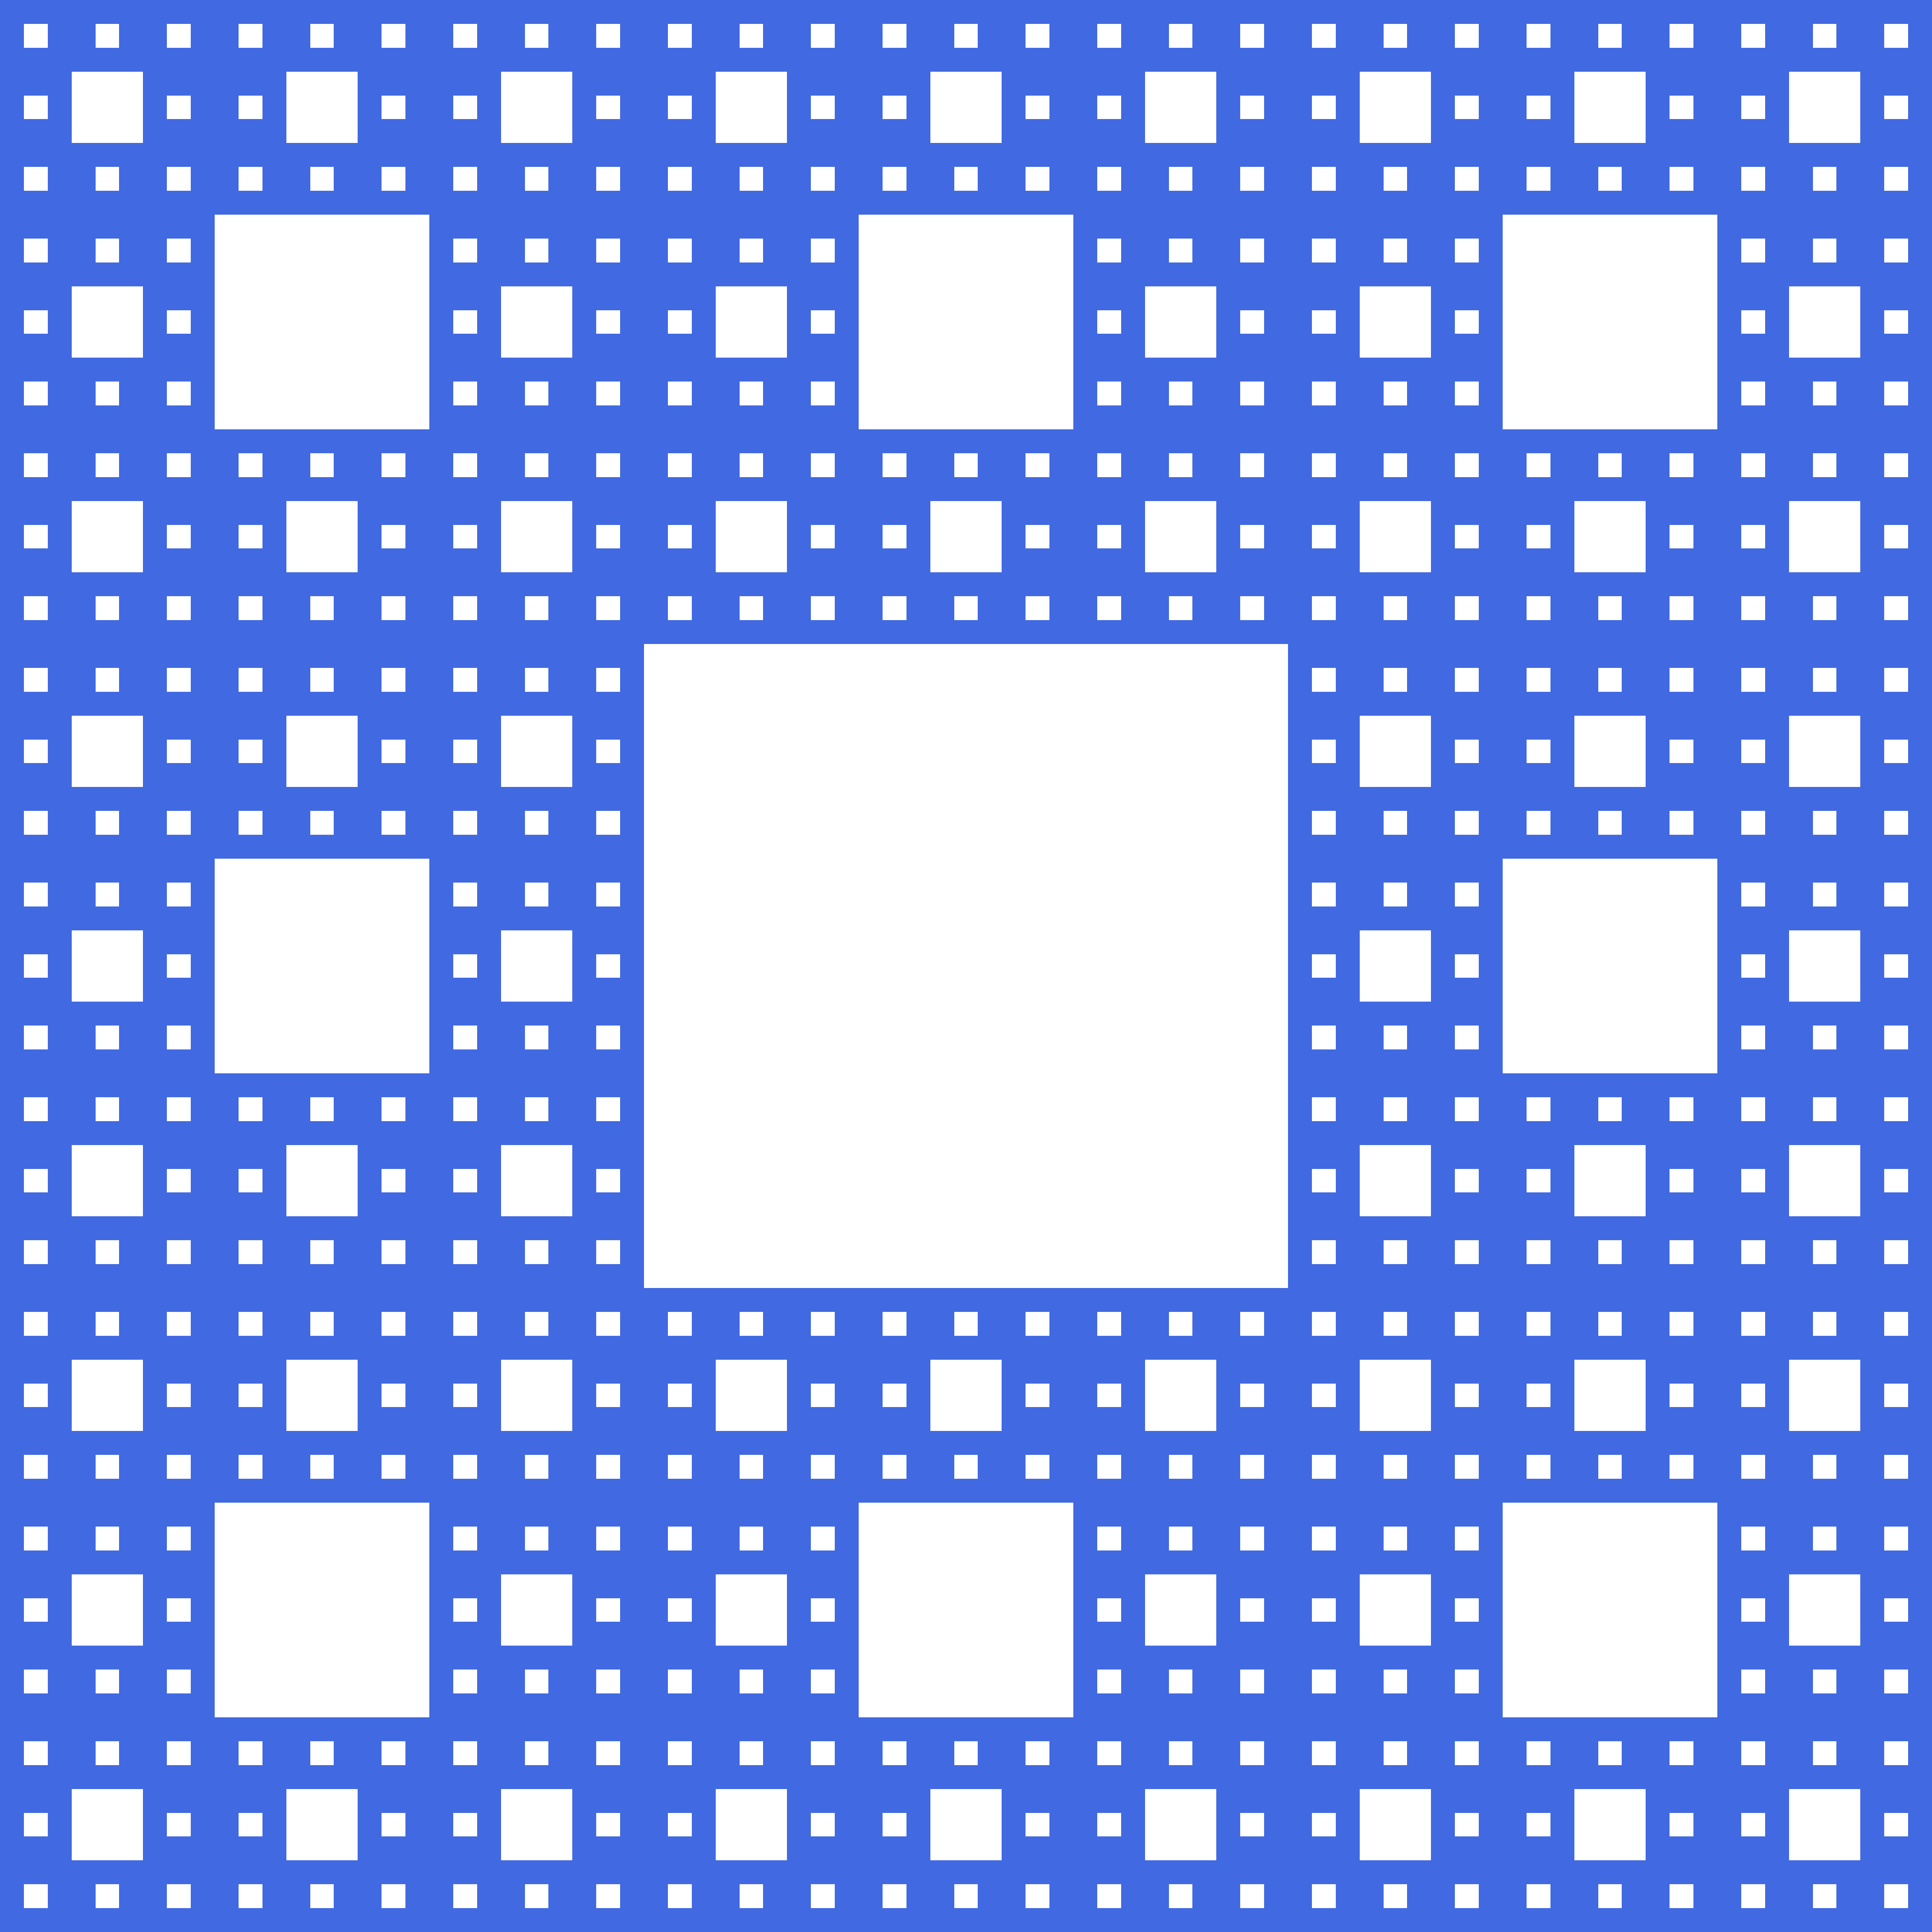
DIY Carpet
Round 4
*Not the Sierpiński Carpet

Slide 17
DIY Carpet (Take 2)
Starting Point

Slide 18
DIY Carpet (Take 2)
Round 1

Slide 19
DIY Carpet (Take 2)
Round 2

Slide 20
DIY Carpet (Take 2)
Round 3

Slide 21
Iterated Function System (IFS)
Given the following transformations:
and ,
we have the Sierpiński Carpet X equal to
The Sierpiński Carpet is the unique fixed set under this mapping and is called an attractor [1].

Slide 22
Continuum
A continuum is a non-empty compact connected metric space. Each iteration is a continuum, but we need to show that the end result is also a continuum.
The intersection of a nested sequence of continua is itself a continuum [2]. Using De Morgan’s laws, we see that for each iteration we have
Then we show via induction that
So clearly
and thus the Sierpiński Carpet is a continuum. This is relevant to the study of calculus on this fractal.

Slide 23
Dimensions
One way to define a fractal is an object whose Hausdorff dimension (D) is greater than its topological dimension (d). D is the Hausdorff dimension and d is the topological, usual dimension [3].
Notice that when you shrink down the carpet by a factor of 3, then you can fit 8 of those copies into the original. This is one way to measure non-integer dimension. There are many other kinds of dimension, all with important roles in characterizing fractals and performing calculus on these spaces.

Slide 24
Applications
The study of fractal dynamics and specifically the Sierpiński Carpet has applications in modelling self-similar structures and porous materials. There is literature on the transport and flow properties of Sierpiński Carpets, so there’s direct application to fluid, heat, and electrical dynamics. Some antennas and electrical circuits are designed around Sierpiński Carpets.
There is a relationship between measures of fractal dimension and how diffusion occurs through similar physical media [4].

Slide 25
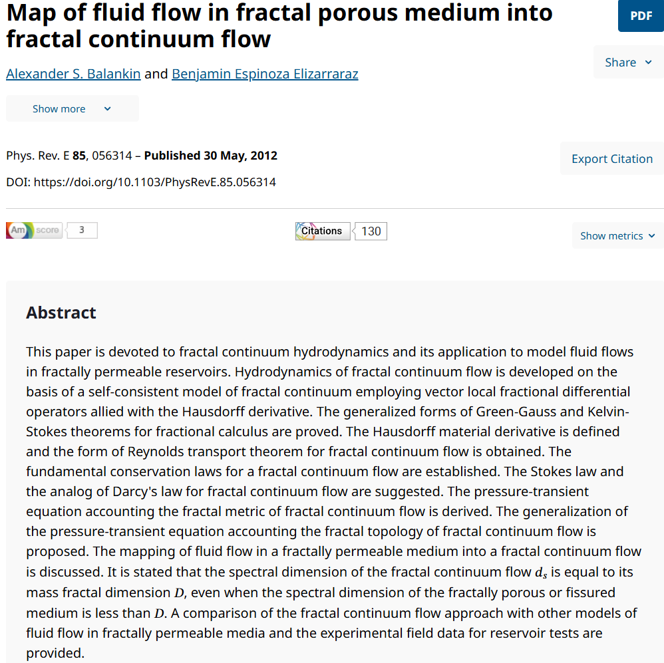
[5]

Slide 26
Calculus
Most fractals are too ‘rough’ to be differentiable in the standard sense, so different approaches are needed. Some use fractional calculus like the below Laplace operator.
This formula has been used to describe physical phenomena in low dimensional semiconductors [6].

Slide 27
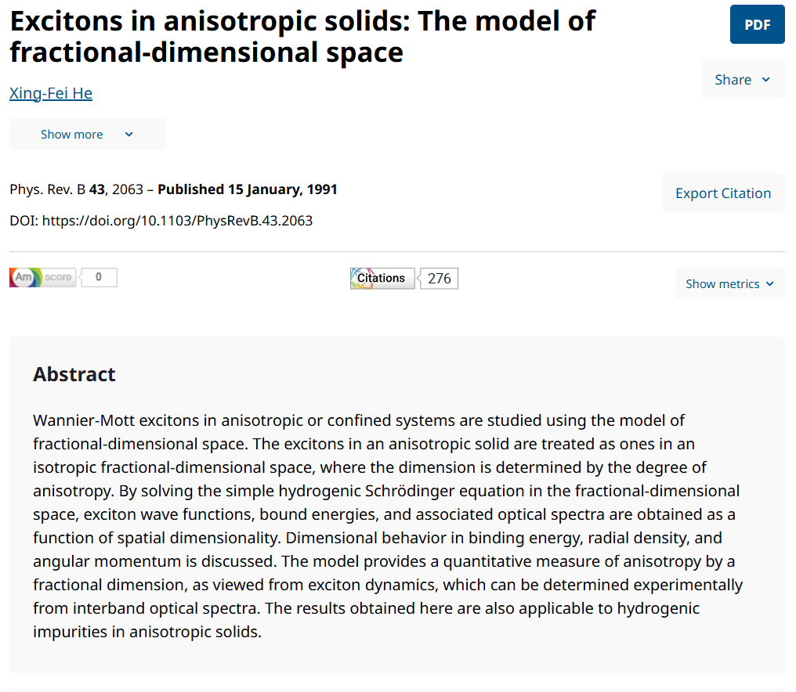
[7]

Slide 28
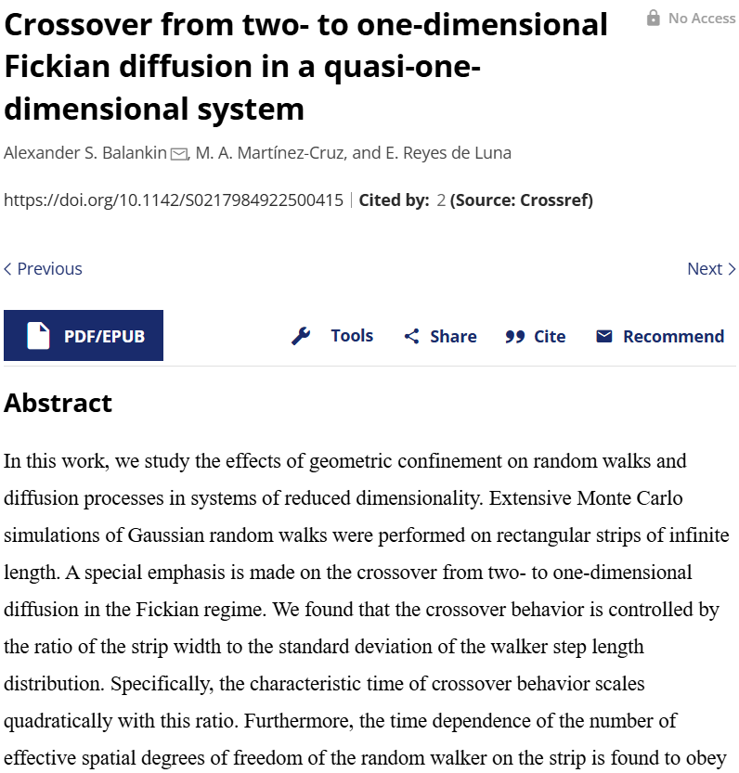
[8]

Slide 29
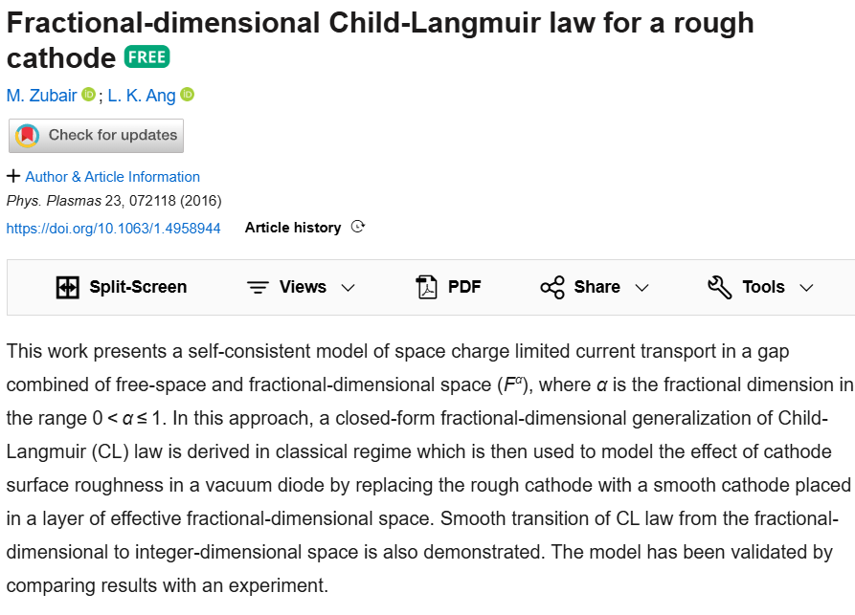
[9]

Slide 30
References
[1] Falconer, K. (2003). Fractal geometry. https://doi.org/10.1002/0470013850
[2] Nadler, S. B. (1992). Continuum Theory: An Introduction.
[3] Ortiz, J. P., Ortiz, M. P., Martínez-Cruz, M., & Balankin, A. S. (2023). A Brief Survey of Paradigmatic Fractals from a Topological Perspective. Fractal and Fractional, 7(8), 597. https://doi.org/10.3390/fractalfract7080597
[4] Balankin, A. S. (2017). The topological Hausdorff dimension and transport properties of Sierpiński carpets. Physics Letters A, 381(34), 2801–2808. https://doi.org/10.1016/j.physleta.2017.06.049
[5] Balankin, A. S., & Elizarraraz, B. E. (2012). Map of fluid flow in fractal porous medium into fractal continuum flow. Physical Review E, 85(5). https://doi.org/10.1103/physreve.85.056314.
[6] Balankin, A. S., & Mena, B. (2023). Vector differential operators in a fractional dimensional space, on fractals, and in fractal continua. Chaos Solitons & Fractals, 168, 113203. https://doi.org/10.1016/j.chaos.2023.113203
[7] He, X. (1991). Excitons in anisotropic solids: The model of fractional-dimensional space. Physical Review. B, Condensed Matter, 43(3), 2063–2069. https://doi.org/10.1103/physrevb.43.2063
[8] Balankin, A. S., Martínez-Cruz, M. A., & De Luna, E. R. (2022). Crossover from two- to one-dimensional Fickian diffusion in a quasi-one-dimensional system. Modern Physics Letters B, 36(12). https://doi.org/10.1142/s0217984922500415
[9] Zubair, M., & Ang, L. K. (2016). Fractional-dimensional Child-Langmuir law for a rough cathode. Physics of Plasmas, 23(7). https://doi.org/10.1063/1.4958944

